Slide 1
Regulación del desarrollo
Docente Alejandra Sierra

Slide 2
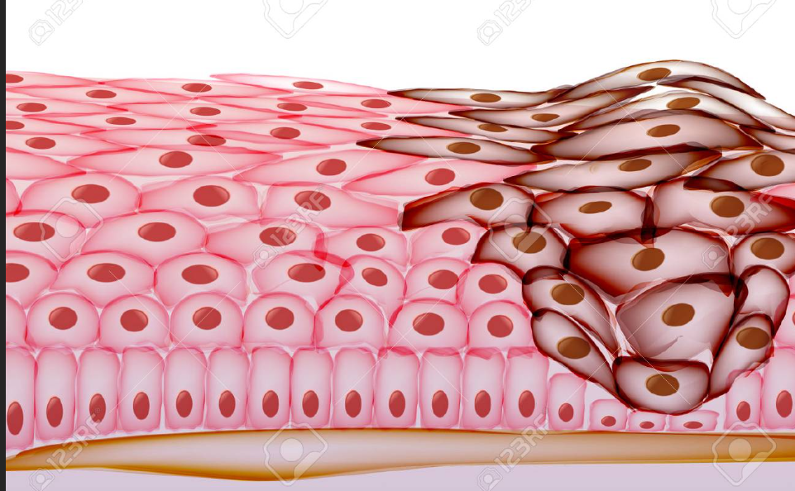
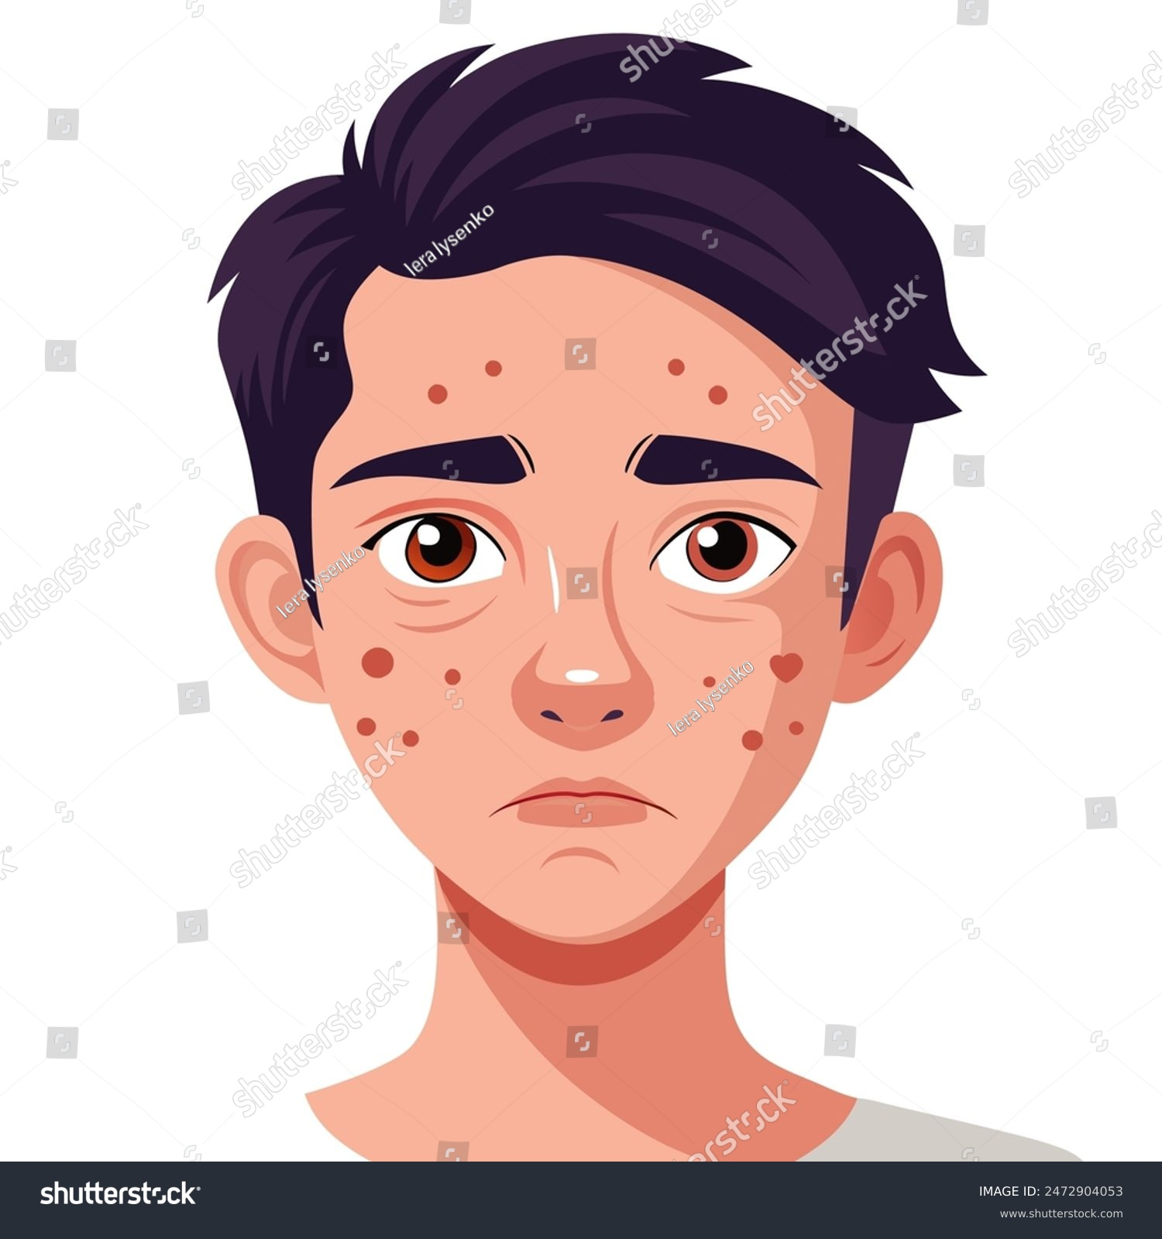
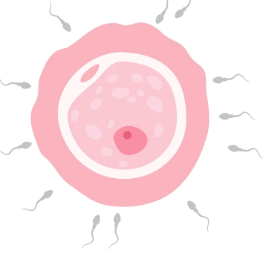
Desarrollo y maduración.
Crecimiento de tejidos
Pubertad
Generación de semejantes

Slide 3
PUBERTAD
Cambios físicos y hormonales. Transición de la niñez a la adultez
Aumento de glándulas mamarias
Voz aguda
Anchamiento de caderas
Vello en axilas, vulva y monte venus
Musculatura menos desarrolada
Primera ovulación
Primera menstruación (Menarquia)

Slide 4
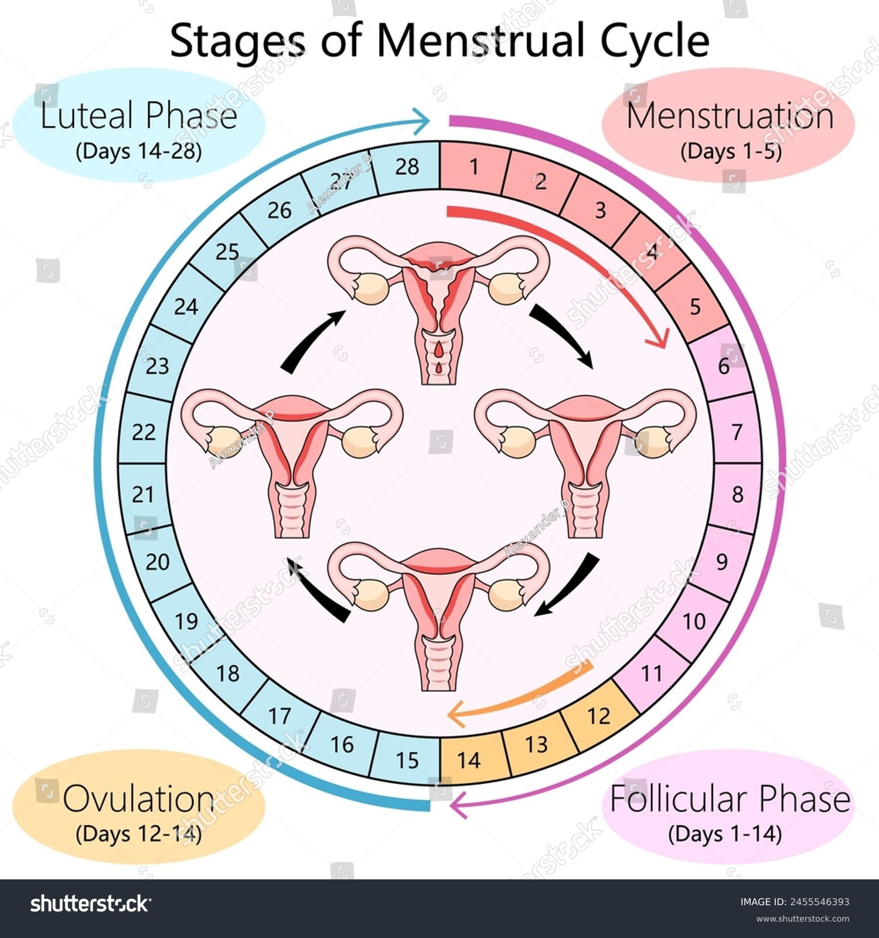

Slide 5
PUBERTAD
Cambios físicos y hormonales. Transición de la niñez a la adultez
Anchamiento de espalda
Voz grave
vello en varias partes del cuerpo
Musculatura más desarrollada
Musculatura más desarrolada
Eyaculaciónes iniciales
Crecimiento del pene y testículos

Slide 6
Hormonas del ciclo menstrual y de la gestación

Slide 7
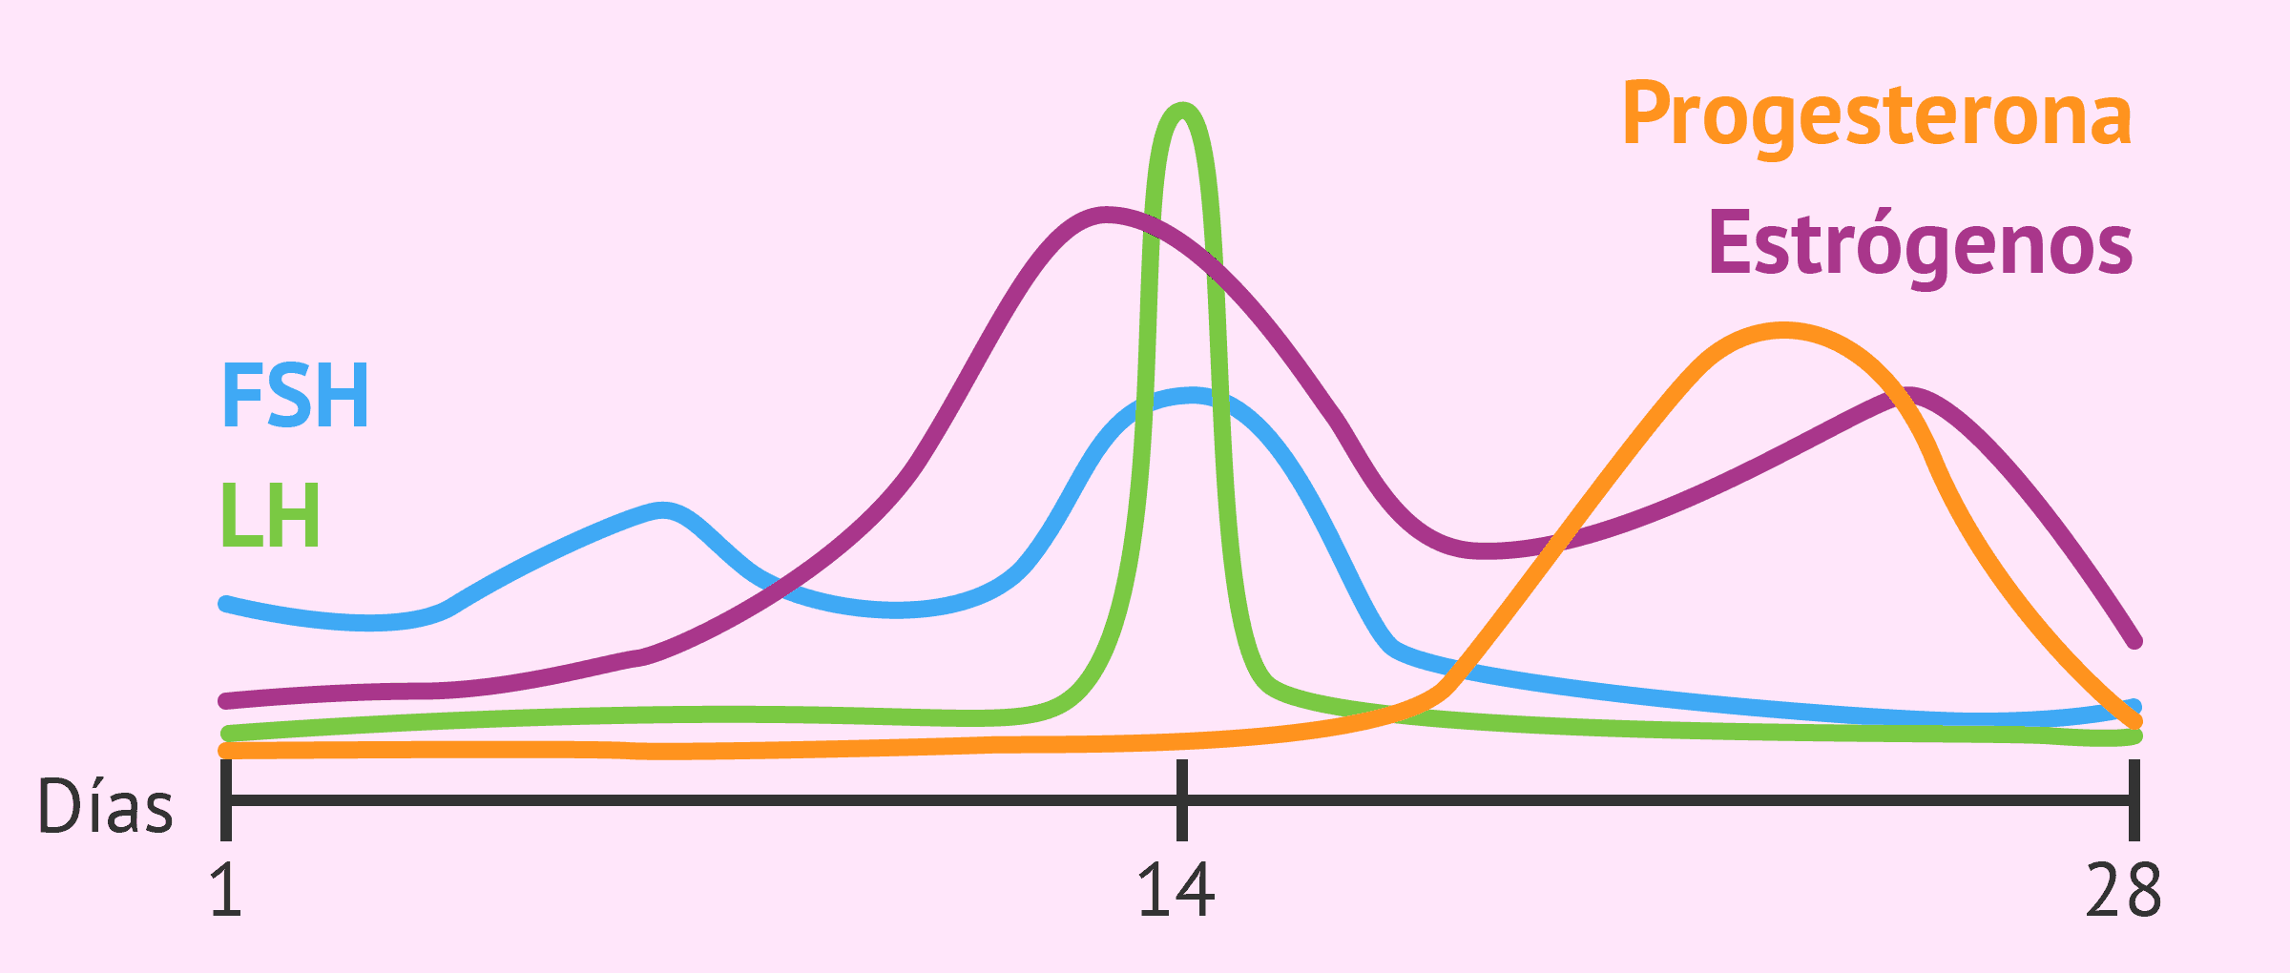
Hormonas del ciclo menstrual

Slide 8
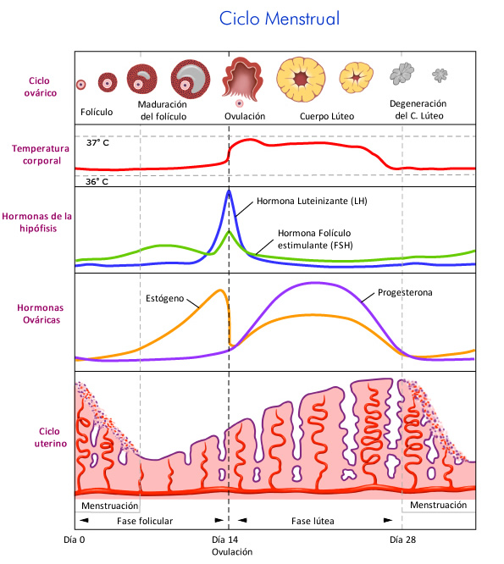

Slide 9
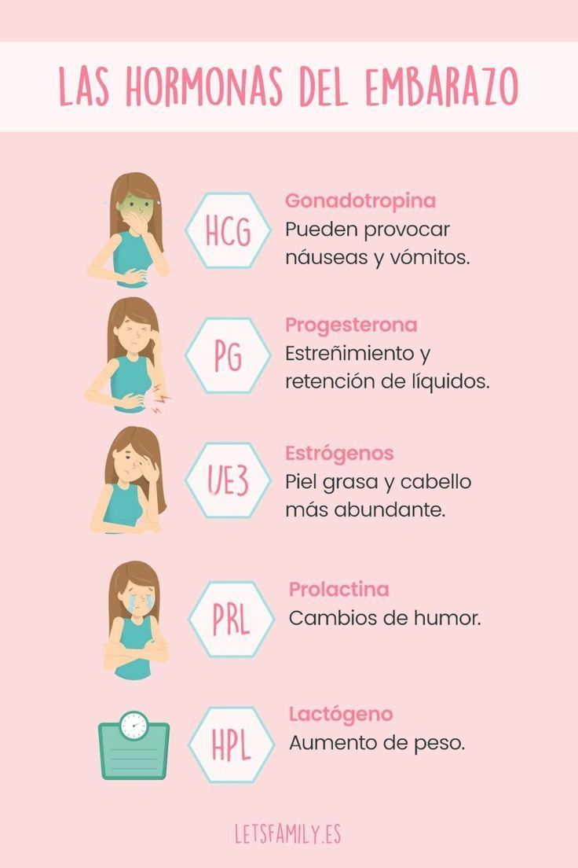
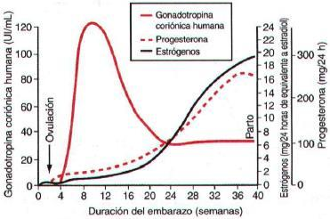

Slide 10
ADOLESCENCIA
Cambios psicológicos y emocionales
Baja tolerancia a la frutración
Incomprensión
Bajo control de impulsos
Emociones complejas
Cercanía a los amigos
Preocupaciones
Más sueño
Distracciones, obstinación
Cambios en la autoestima
Desarrollo personalidad

Slide 11
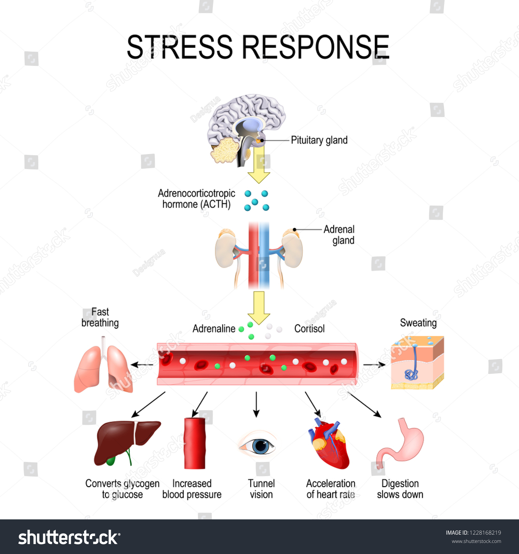
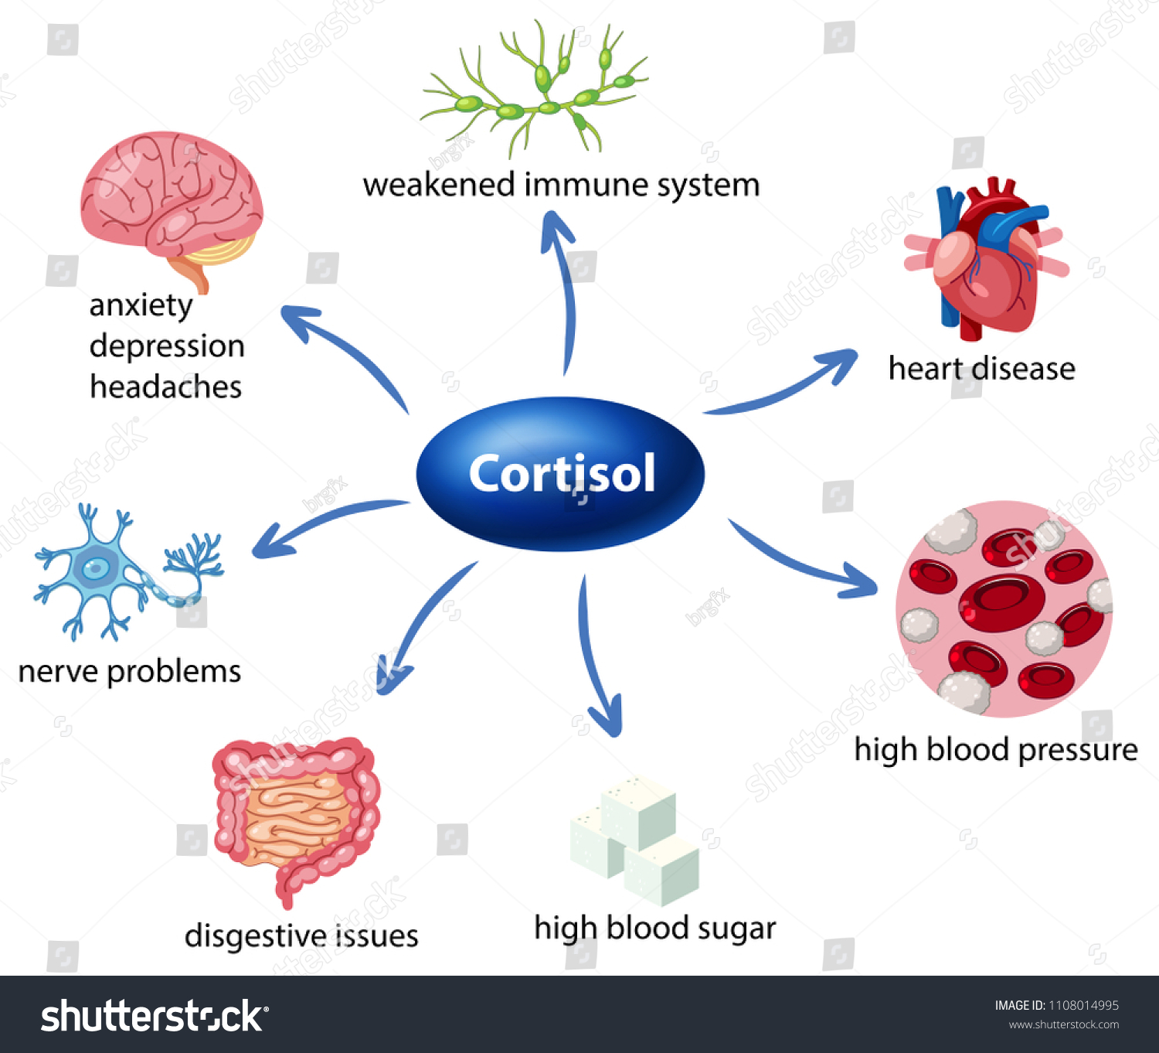
Reacciones a estres

Slide 12
Comportamiento en adolescentes
55%
Mal humor e irritabilidad
44%
37%
Desafío - rebelión
65%
39%
Consumo de alcohol o drogas
80%
61%
Retención de información
64%
50%
Altibajos en la escuela
72%

Slide 13
Comportamiento adolescente
Aumento de argumentos
58%
Afianzamiento orientación
Cambio en la apariencia
75%
Exploración identidad
Altibajos emocionales
45%
Dudas de la orientación

Slide 14
Gracias!

Slide 16
Teenager behavior infographics
Common teenager behavior and solutions
Increase use of social media
Lying or hiding facts
Decreased communication
Solution
Solution
Solution
Jupiter is the fourth-brightest object in the night sky. It was named after a Roman god
Saturn is composed mostly of hydrogen and helium. It was named after the Roman god of wealth
Despite being red, Mars is a cold place. It's full of iron oxide dust, which gives the planet its reddish cast

Slide 17
Teenager behavior infographics
Ways to cope with typical teen behavior
Venus is the second planet from the Sun and is terribly hot
Despite being red, Mars is actually a cold place
The Sun is the star at the center of the Solar System
Pluto is considered a dwarf planet, not a full-fledged planet
Listen to their needs
Give them privacy
Express your concern
Set boundaries
Saturn is composed mostly of hydrogen and helium
Mercury is the smallest planet in the Solar System
Jupiter is a gas giant and the biggest planet of them all
Neptune is the fourth-largest planet by diameter

Slide 18
Teenager behavior infographics
Parents: how can you help your teen during this transition?
Give them privacy
Actively listen
Stay connected
Jupiter is the biggest planet in the Solar System
Saturn is a gas giant and has several rings
Neptune is the fourth-largest planet by diameter
Keep promises
Set boundaries
Talk to them
Praise them
Mercury is the smallest planet of them all
The Sun is the star at the center of the Solar System
Venus is the second planet from the Sun
Despite being red, Mars is actually a cold place

Slide 19
Teenager behavior infographics
Signs of abnormal behavior
Shunning social activity
Risky behavior
Mercury is the smallest planet of them all one in the Solar System—it’s only a bit larger than the Moon
Despite being red, Mars is a cold place. It's full of iron oxide dust, which gives the planet its reddish cast
Extreme symptoms
Harming themselves
Saturn is composed mostly of hydrogen and helium. It was named after the Roman god of wealth
Earth is the third planet from the Sun and the only one that harbors life. This is where we all live on

Slide 20
Teenager behavior infographics
Mood swings
Earth is the third planet from the Sun and the only one that harbors life in the Solar System
Loss of control
Abnormal behavior
Mercury is the closest planet to the Sun and the smallest one in the Solar System
Neptune is the fourth-largest planet by diameter
Aggression
Venus is terribly hot, even hotter than Mercury, and its atmosphere is poisonous

Slide 21
Teenager behavior infographics
Typical behaviors
Abnormal behaviors
Saturn is composed mostly of hydrogen and helium. It was named after the god of wealth
Jupiter is the fourth-brightest planet and was named after the Roman god of the skies
Despite being red, Mars is actually a cold place. It’s full of iron oxide dust
Mercury is the closest planet to the Sun and the smallest in the Solar System
Earth is the third planet from the Sun and the only one that harbors life in the Solar System
Venus is terribly hot, even hotter than Mercury, and its atmosphere is poisonous

Slide 22
Teenager behavior infographics
Identifying typical and abnormal behavior in teens
 |  | Typical behavior | Abnormal behavior
 | Changing one’s appearance
 | Being physically abusive to others
 | Increased arguments
 | Staying out all night

Slide 23
Teenager behavior infographics
Typical behavior in teens
Sleeping longer
Eating more
Relationships changes
Pluto is now considered a dwarf planet
Ceres is located in the main asteroid belt
Jupiter is the biggest planet of them all
Abnormal behavior in teens
Unprotected sex
Drug use
Violence
Despite being red, Mars is actually a very cold place
Neptune is the farthest planet from the Sun
Venus is the second planet from the Sun

Slide 24
Teenager behavior infographics
Teen behavior: when is it normal and when is it a reason of concern?
Typical behaviors
Abnormal behaviors
1
Mild anxiety
Extreme anxiety
1
Jupiter is a gas giant and the biggest planet
Venus is the second planet from the Sun
2
Sleeping a lot
Sleep all the time
2
The Sun is the star at the center of the Solar System
The Moon is Earth’s only natural satellite
3
Experimenting sex
Unprotected sex
3
Despite being red, Mars is actually a cold place
Neptune is the farthest planet from the Sun
4
Avoid some activities
Avoid all social activities
4
Saturn is a gas giant and has several rings
Ceres is located in the main asteroid belt

Slide 25
Teenager behavior infographics
Typical behaviors
Abnormal behaviors
Saturn is a gas giant and has several rings. It’s composed mostly of hydrogen and helium and was named after a Roman god
Mercury’s name has nothing to do with the liquid metal, since this planet was named after the Roman messenger god
Selfishness
Constant need to argue
74%
35%
Curfew violations
Being verbally abusive
36%
46%
Sexual experimentation
Getting arrested
52%
19%

Slide 26
Teenager behavior infographics
Typical teen behavior
Potentially concerning behavior
Shunning some social activities
Shunning all social activity
Venus has a beautiful name and is the second planet from the Sun
Mars is full of iron oxide dust, which gives the planet its reddish cast
Sadness
Depression
Mercury is the closest planet to the Sun and the smallest one in the System
Jupiter is a gas giant and the biggest planet in the Solar System
Experimenting with certain things
Risky behavior
Earth is the third planet from the Sun and the only one that harbors life
Neptune is the fourth-largest planet by diameter in the Solar System

Slide 27
Teenager behavior infographics
Typical behavior
Jupiter is a gas giant and the biggest planet
Saturn is a gas giant and has several rings
Earth is the third planet from the Sun and the only one that harbors life
Abnormal behavior
Despite being red, Mars is actually a cold place
The Sun is the star at the center of the Solar System
Neptune is the fourth-largest planet by diameter in the entire Solar System

Slide 28
Teenager behavior infographics
How to handle your teen’s disrespectful behavior?
1
2
3
4
5
Understand the teenage brain
Be a role model to your teen
Ignore mild forms of disrespect
Set clear boundaries
Try to understand their new needs
The Sun is the star at the center of the Solar System
Mercury is the smallest planet of them all
Venus is the second planet from the Sun
Jupiter is the biggest planet in the Solar System
Saturn is a gas giant and has several rings

Slide 29
Teenager behavior infographics
How to handle disrespectful behavior
1
Understand their needs
The Sun is the star at the center of the Solar System
2
Give them independence
Despite being red, Mars is actually a very cold place
3
Avoid unnecessary arguments
Jupiter is a gas giant and the biggest planet of them all

Slide 30
Teenager behavior infographics
Sample behavior chart
 | Rule | Privilege | Consequence
 | Venus has a beautiful name and is the second planet from the Sun | Jupiter is the fourth-brightest planet and it was named after a Roman god | Saturn is composed of hydrogen and helium. It was named after a Roman god
 | Earth is the third planet from the Sun and the only one that harbors life | Venus is terribly hot, even hotter than Mercury, and its atmosphere is poisonous | Neptune is the fourth-largest planet by diameter in the Solar System
 | Mars is full of iron oxide dust, which gives the planet its reddish cast | The Moon is Earth’s only natural satellite, and it always faces our planet | Uranus is the seventh planet from the Sun and has the third-largest diameter

Slide 31
Teenager behavior infographics
Teenagers and drugs: stats
35%
26%
22%
20%
16%
Marijuana
Alcohol
Pills
Hookah
Cocaine
Despite being red, Mars is actually a cold place. It’s full of iron oxide dust
Mercury is the closest planet to the Sun and the smallest one
Venus has a beautiful name, but also high temperatures
Jupiter is a gas giant and the biggest planet in the Solar System
Neptune is the fourth-largest planet by diameter in the Solar System

Slide 32
Teenager behavior infographics
How can teens deal with bullying?
1
Tell a trusted adult
Earth is the third planet from the Sun and the only one that harbors life in the Solar System
2
Don't get physical
Despite being red, Mars is actually a cold place. It's full of iron oxide dust
3
Ignore the bully and walk away
Venus is terribly hot, even hotter than Mercury, and its atmosphere is poisonous
4
Stand up for friends you see being bullied
Jupiter is the fourth-brightest planet in the night sky. It was named after a Roman god

Slide 33
Teenager behavior infographics
Usual teenage problems
Self-esteem and body image
Underage sex
Mercury is the smallest planet
Jupiter is a gas giant
Cyber addiction
Defiant behaviors
Venus has a beautiful name
Neptune is far away from us
Drinking and smoking
Peer-pressure and competition
Earth is the planet that harbors life
Pluto is a dwarf planet
Teen pregnancy
Depression
Mars is actually a cold place
The Sun is the closest star to Earth

Slide 34
Teenager behavior infographics
Most common risky behavior
Unprotected sex
Mercury is the smallest planet of them all in the Solar System
38%
Use of drugs
Venus has a beautiful name and is the second planet from the Sun
20%
Bullying
Despite being red, Mars is a cold place full of iron oxide dust
17%
Alcohol abuse
Jupiter is a gas giant and the biggest planet in the Solar System
13%

Slide 35
Teenager behavior infographics
Teenager problems
Stress
Trust
The Sun is the star at the center of the Solar System
Saturn is a gas giant and has several rings
Acceptance
Depression
Bullying
Jupiter is the biggest planet in the Solar System
Neptune is the fourth-largest planet by diameter
Venus is the second planet from the Sun

Slide 36
Teenager behavior infographics
Teen problems: stats
Depression | Bullying | Drug use | Obesity | Alcohol consumpt.
Earth is the third planet from the Sun and the only one that harbors life | Neptune is the fourth-largest planet by diameter in the Solar System | Mercury is the closest planet to the Sun and the smallest in the Solar System | Venus has a beautiful name and is the second planet from the Sun | Jupiter is a gas giant and the biggest planet in the entire Solar System
18% | 20% | 6% | 20% | 30%

Slide 37
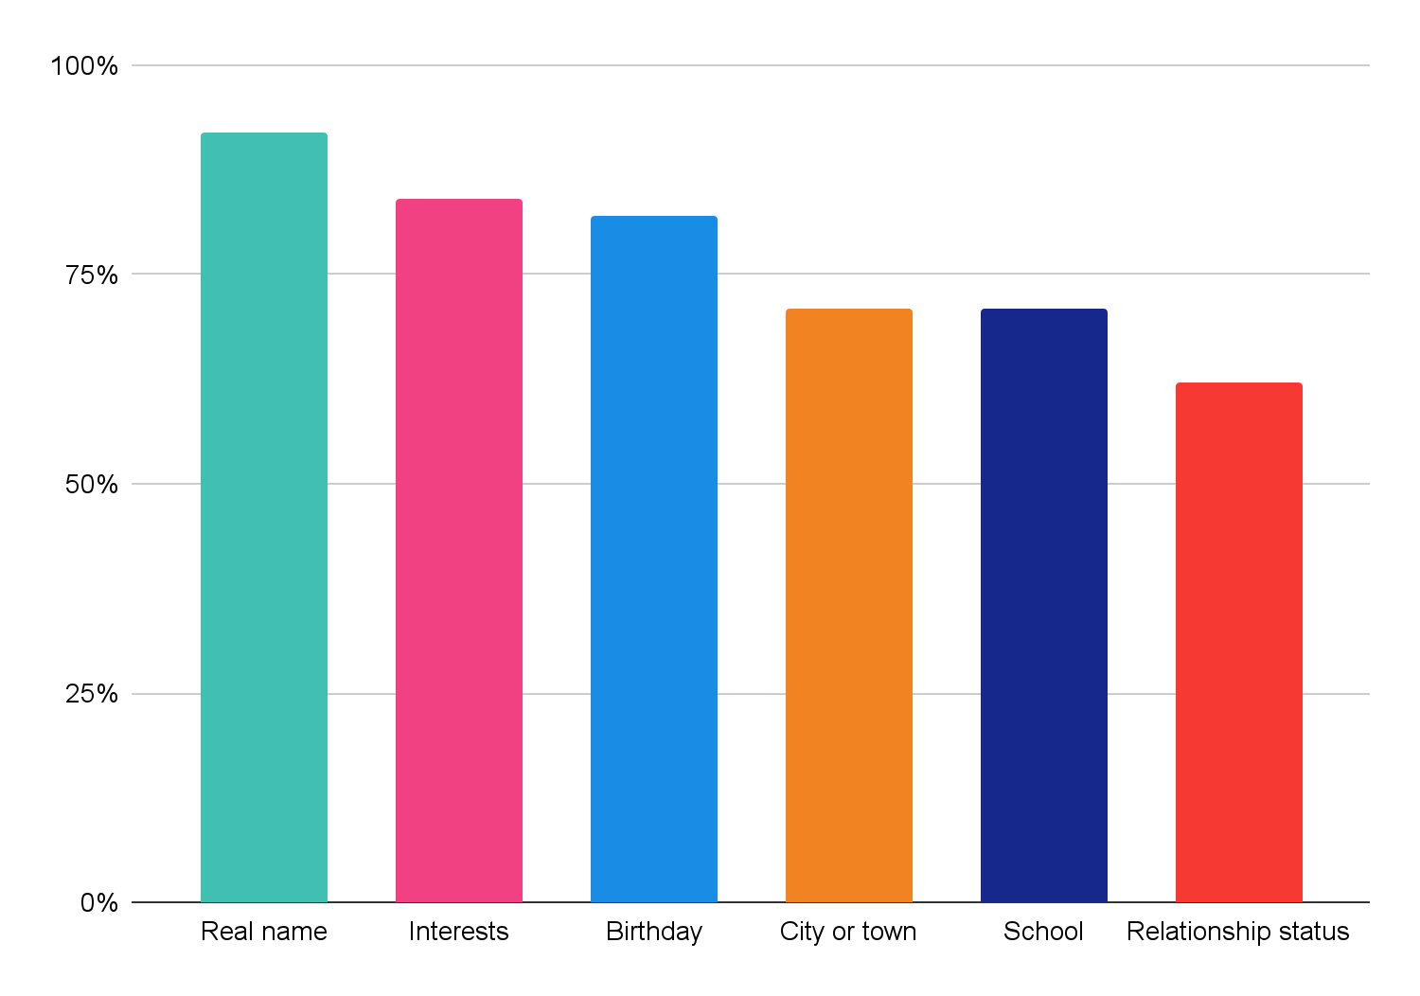
Teenager behavior infographics
Are teens giving too much information on social media?
Personal information
Contact information
53%
Email address
The Sun is the star at the center of the Solar System
20%
Phone number
Jupiter is a gas giant and the biggest planet of them all
Follow the link in the graph to modify its data and then paste the new one here. For more info, click here

Slide 38
Teenager behavior infographics
How to build a healthy relationship with teens
Early identification
Trust and acceptance
Jupiter is a gas giant and the biggest planet in the Solar System
Earth is the third planet from the Sun and the only one that harbors life
Understanding transition
Create a safe space
Mercury is the closest planet to the Sun and the smallest of them all
Neptune is the fourth-largest planet in the Solar System
Transferring knowledge
Seeking help
Saturn is a gas giant. It’s composed mostly of hydrogen and helium
Venus is terribly hot, even hotter than Mercury, and its atmosphere is poisonous

Slide 39
Teenager behavior infographics
How to encourage good behavior in teens?
Set clear rules
Choose your battles
Take your teen seriously
The Sun is the star at the center of the Solar System
Venus is the second planet from the Sun
Despite being red, Mars is actually a very cold place
Share your feelings
Learn to live with mistakes
Respect their privacy
Ceres is located in the main asteroid belt
Jupiter is a gas giant and the biggest planet of them all
Neptune is the farthest planet from the Sun

Slide 40
Teenager behavior infographics
Reinforce good behavior with this teen-approved rewards
Hugs
A subscription
Concert tickets
Venus is the second planet from the Sun
Saturn is a gas giant and has several rings
The Sun is the star at the center of the Solar System
Extended curfew
Favorite meal
New clothes
Jupiter is the biggest planet in the Solar System
Despite being red, Mars is actually a cold place
Neptune is the fourth-largest planet by diameter

Slide 41
Icon pack: self awareness | linear color

Slide 42
Instructions for use
In order to use this template, you must credit Slidesgo in your final presentation.
You are allowed to:
- Modify this template.
- Use it for both personal and commercial projects.
You are not allowed to:
- Sublicense, sell or rent any of Slidesgo Content (or a modified version of Slidesgo Content).
- Distribute Slidesgo Content unless it has been expressly authorized by Slidesgo.
- Include Slidesgo Content in an online or offline database or file.
- Offer Slidesgo templates (or modified versions of Slidesgo templates) for download.
- Acquire the copyright of Slidesgo Content.
For more information about editing slides, please read our FAQs or visit Slidesgo School:
https://slidesgo.com/faqs and https://slidesgo.com/slidesgo-school

Slide 43
Instructions for use (premium users)
As a Premium user, you can use this template without attributing Slidesgo.
You are allowed to:
Modify this template.
Use it for both personal and commercial purposes.
Hide or delete the “Thanks” slide and the mention to Slidesgo in the credits.
Share this template in an editable format with people who are not part of your team.
You are not allowed to:
Sublicense, sell or rent this Slidesgo Template (or a modified version of this Slidesgo Template).
Distribute this Slidesgo Template (or a modified version of this Slidesgo Template) or include it in a database or in any other product or service that offers downloadable images, icons or presentations that may be subject to distribution or resale.
Use any of the elements that are part of this Slidesgo Template in an isolated and separated way from this Template.
Register any of the elements that are part of this template as a trademark or logo, or register it as a work in an intellectual property registry or similar.
For more information about editing slides, please read our FAQs or visit Slidesgo School:
https://slidesgo.com/faqs and https://slidesgo.com/slidesgo-school

Slide 44
Infographics
You can add and edit some infographics to your presentation to present your data in a visual way.
Choose your favourite infographic and insert it in your presentation using Ctrl C + Ctrl V or Cmd C + Cmd V in Mac.
Select one of the parts and ungroup it by right-clicking and choosing “Ungroup”.
Change the color by clicking on the paint bucket.
Then resize the element by clicking and dragging one of the square-shaped points of its bounding box (the cursor should look like a double-headed arrow). Remember to hold Shift while dragging to keep the proportions.
Group the elements again by selecting them, right-clicking and choosing “Group”.
Repeat the steps above with the other parts and when you’re done editing, copy the end result and paste it into your presentation.
Remember to choose the “Keep source formatting” option so that it keeps the design. For more info, please visit Slidesgo School.

